Slide 1
Outline of Workshop
First thing: How to use Jupyter Notebooks Morning (pre-break):
Introduction to statistics and the autocorrelation function
Basic theory of time series analysis: autocovariance matrix, periodicity, aliasing, stochastic realizations, hands-on simulation
Introduction to time series models in R and Python
Morning (post-break):
Time series analysis in R and Python: autocorrelation function estimation, time series decomposition, trend analysis, harmonic regression
Hands-on analysis of environmental time series
Afternoon:
Extension of autocorrelation to spatial dimensions
Spatial autocovariance matrices and pair-wise distance functions
Fitting simple spatial models in R and Python

Slide 2
How to use Jupyter

Slide 3
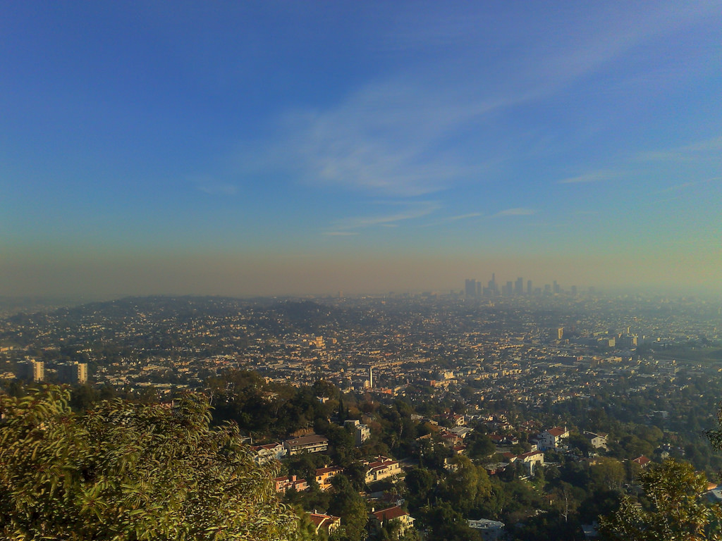







An Introduction to Environmental Statistics
UCI Data Science Initiative Short Course Gregory Britten (gbritten@uci.edu), Yara Mohajerani (ymohajer@uci.edu)

Slide 4
Is there a statistical trend in observed air quality? Are times of the year systematically worse? What environmental factors contribute to the trend?

Slide 5
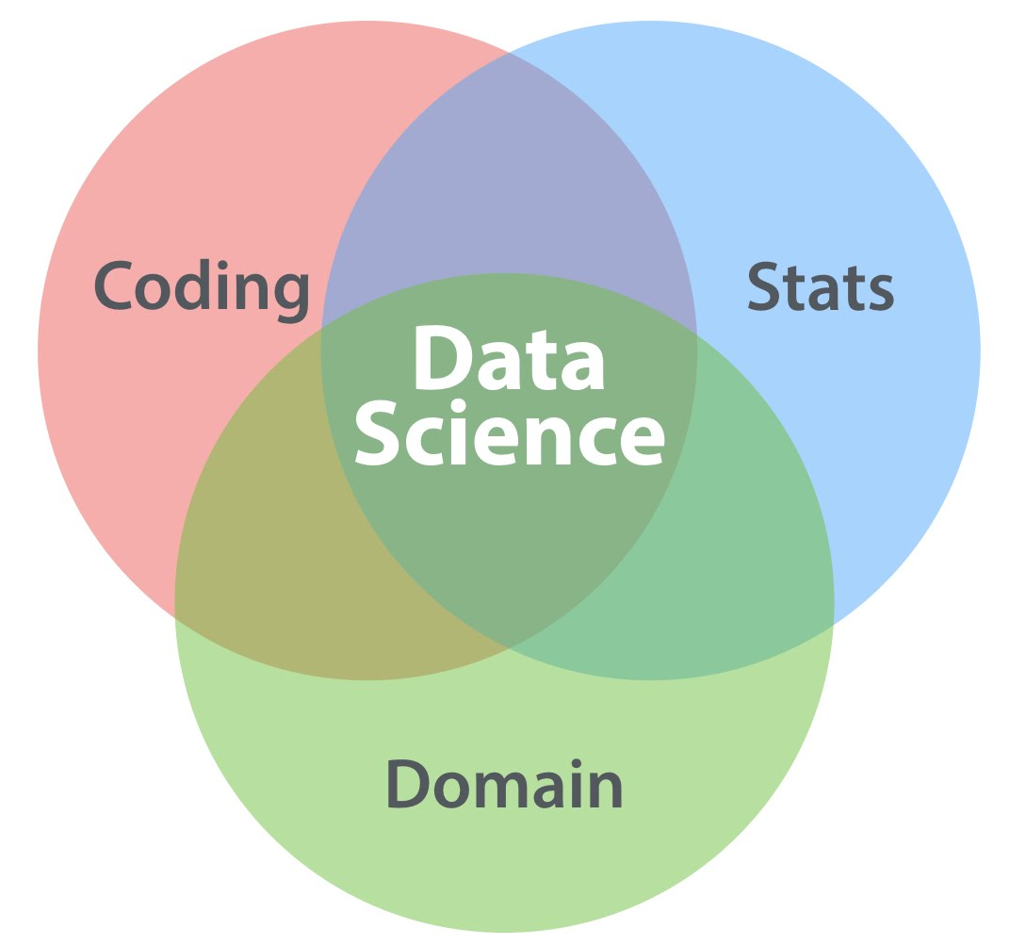
Goals of Applied Statistics
Goal of statistics is to learn about the data-generating process
Goals of applied statistics thus often aligned with applied science
Today
DATALAB.CC

Slide 6
Characteristics of environmental data
Collected in time and/or space
Seasonal, daily, and other cycles
Colinearity among variables
Observational, measurement error

Slide 7
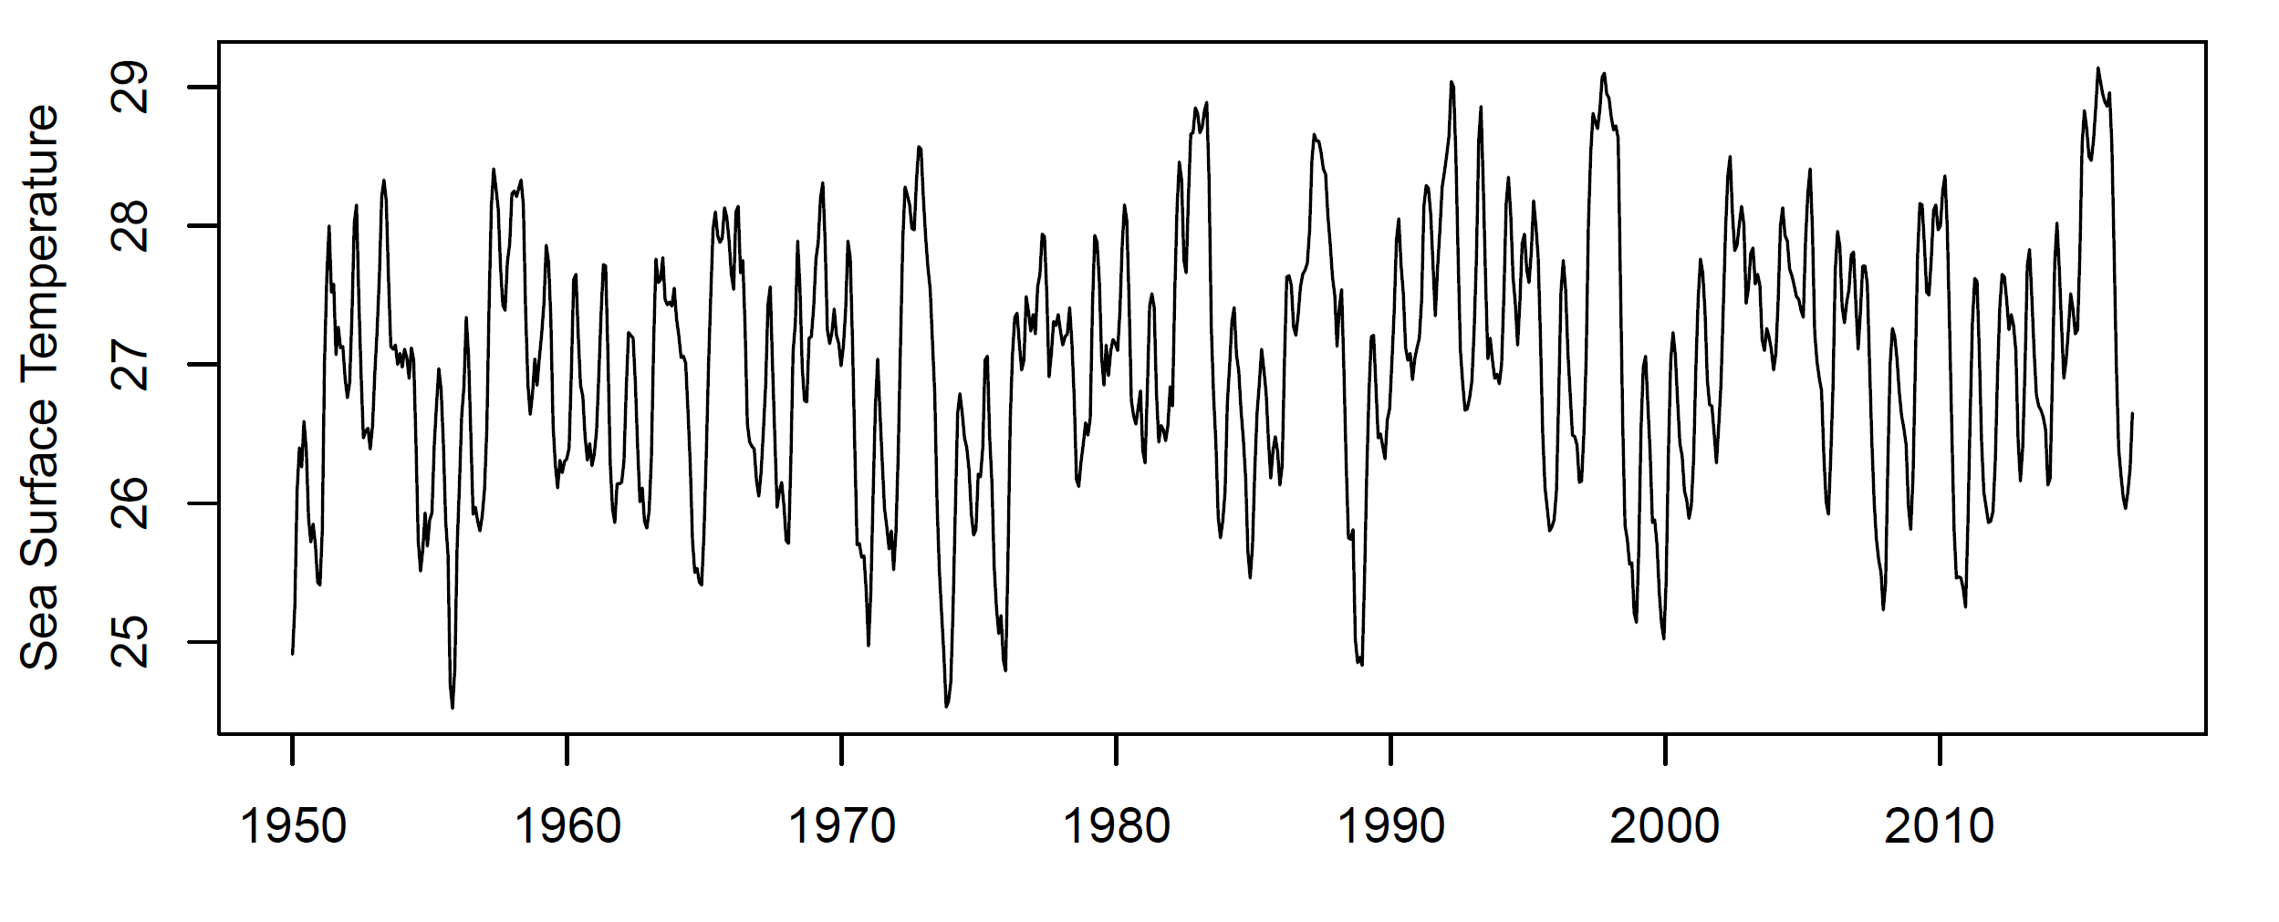
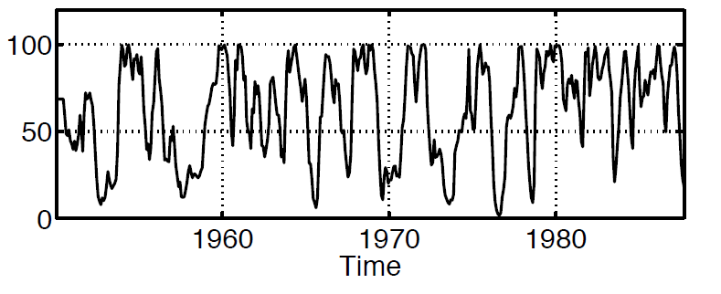
Sea Surface Temperature
Global mean monthly air temperature anomaly
Periodicity, trend, ‘runs’

Slide 8
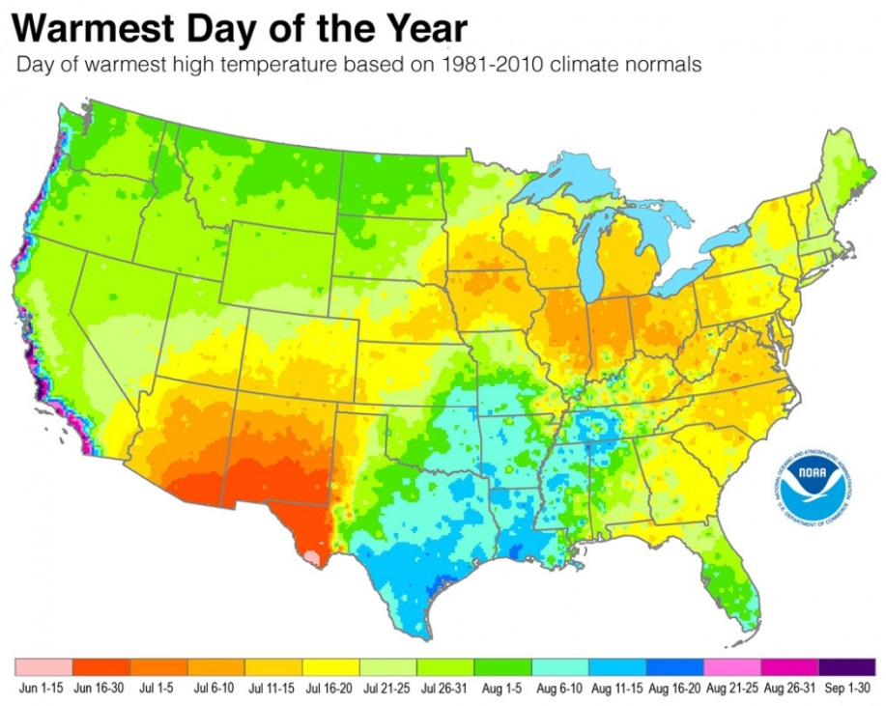
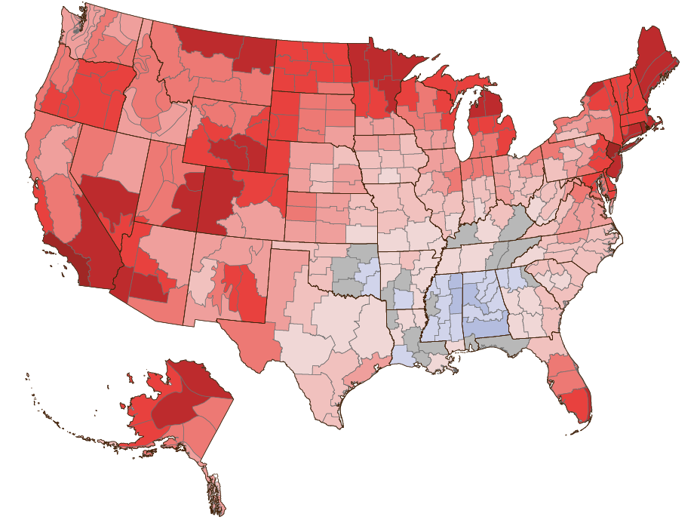
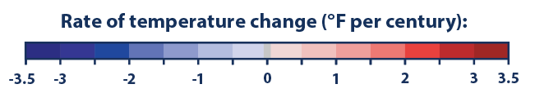
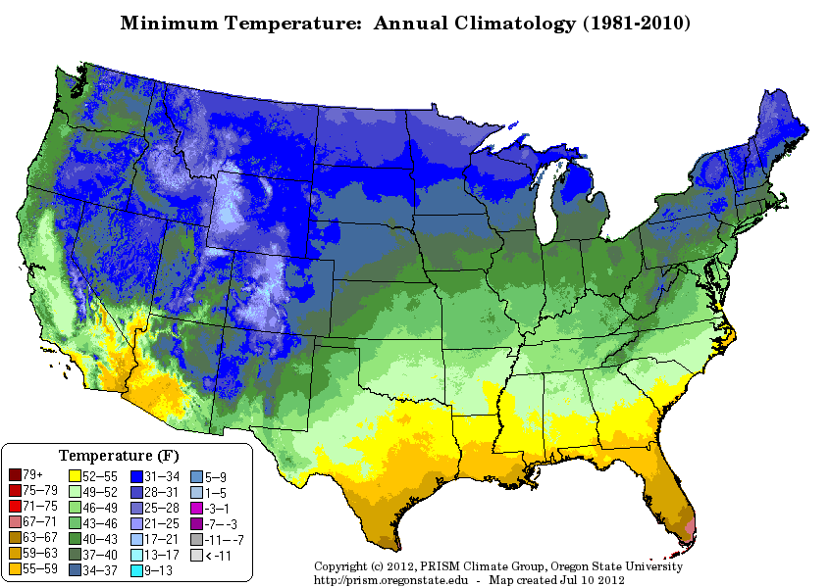
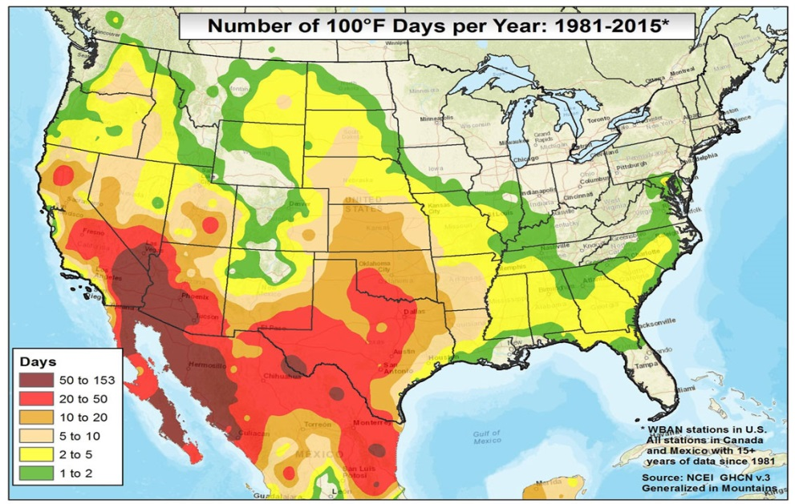

Slide 9

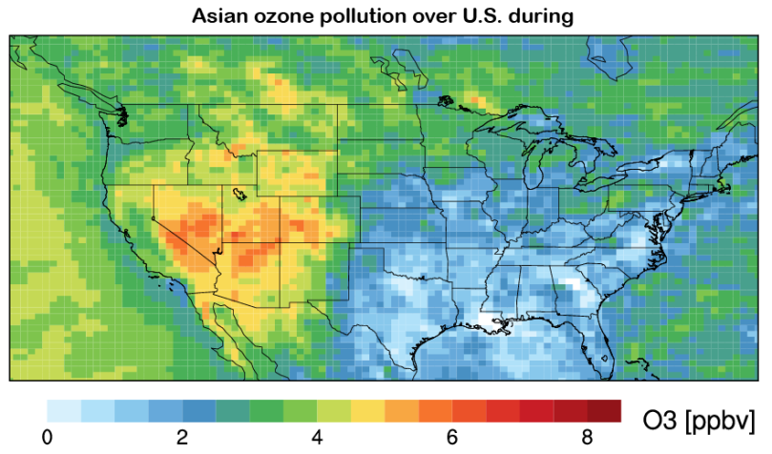
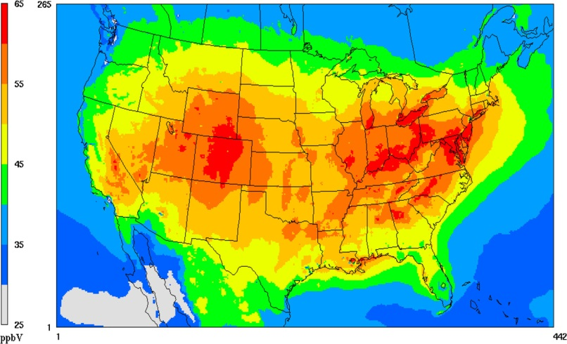
Utah department of environment claims research demonstrates Asian source of ozone, meaning the state is not in violation of EPA Empirical science hotly contested: statisticians to the rescue!
We will see how properly treating spatial/temporal properties is critical to empirical inference

Slide 10
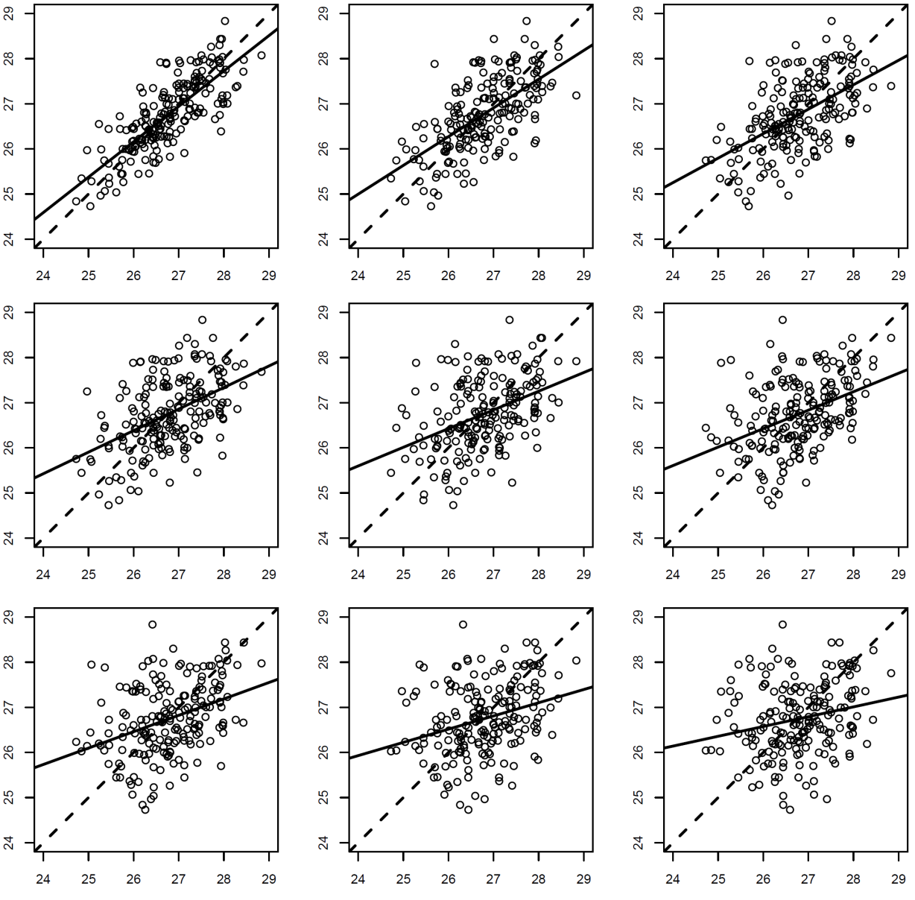
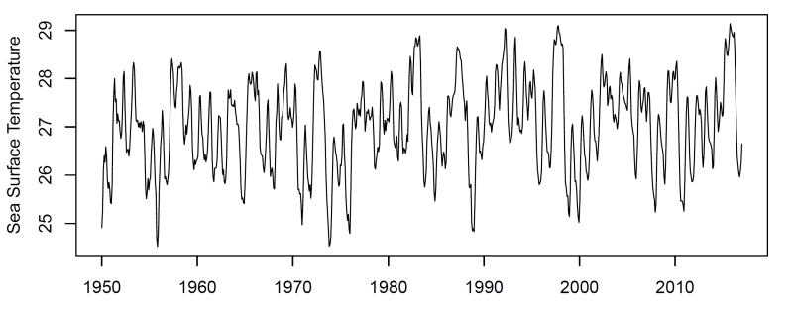
What Generates the Pattern? Key concept: correlation as a function of lag
Places closer to one another are more similar
Correlation falls away as a function of lag

Slide 11
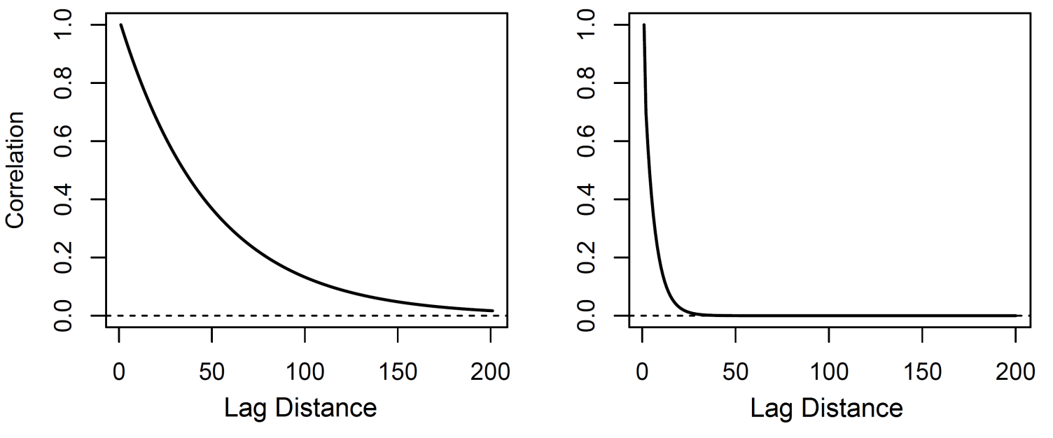
Autocorrelation functions
Places closer to one another are more similar
Correlation falls away as a function of lag

Slide 12
WHY SHOULD ENVIRONMENTAL SCIENTISTS CARE?
Two Reasons
Learn about the dynamics of the environmental process, understanding structure in data
Magnitude of autocorrelation controls the quantity of information in space/time data. The width of confidence intervals, p.values, posterior probabilities, and other empirical inferences depend critically on characterizing the autocorrelation, as we shall see…

Slide 13
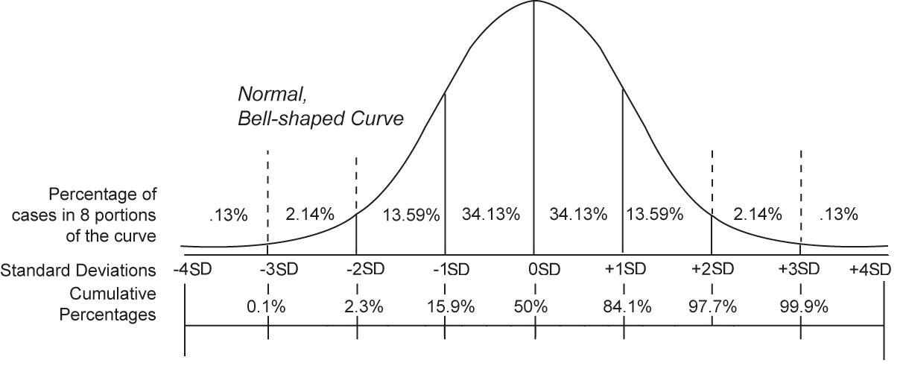
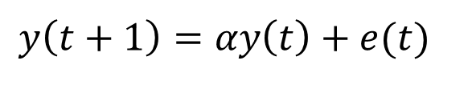
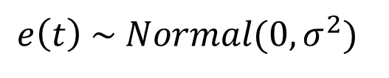
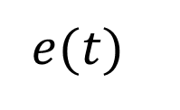
The concept of stochastic realization
$$y\left(t+1\right)=αy\left(t\right)+e(t)$$
$$e\left(t\right) \sim Normal(0,σ^{2})$$
*first-order linear autoregressive model
$$e(t)$$

Slide 14
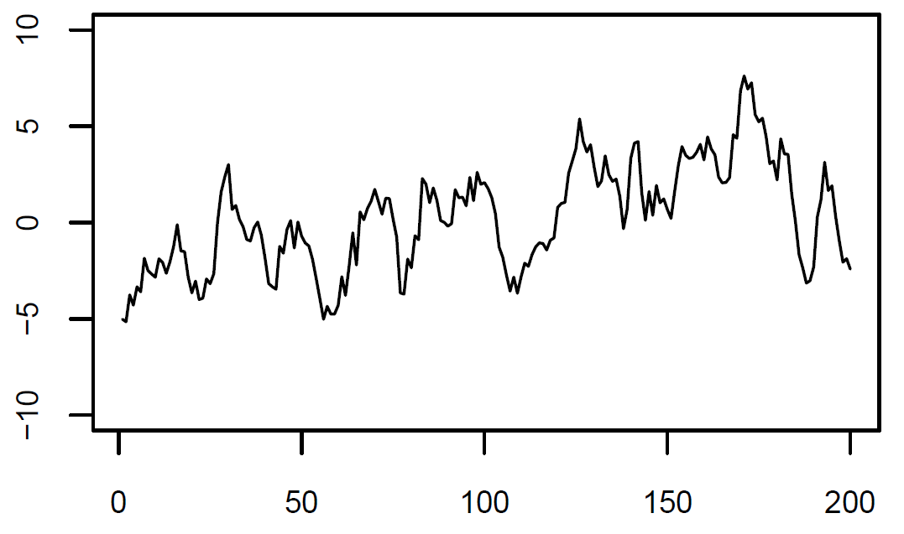
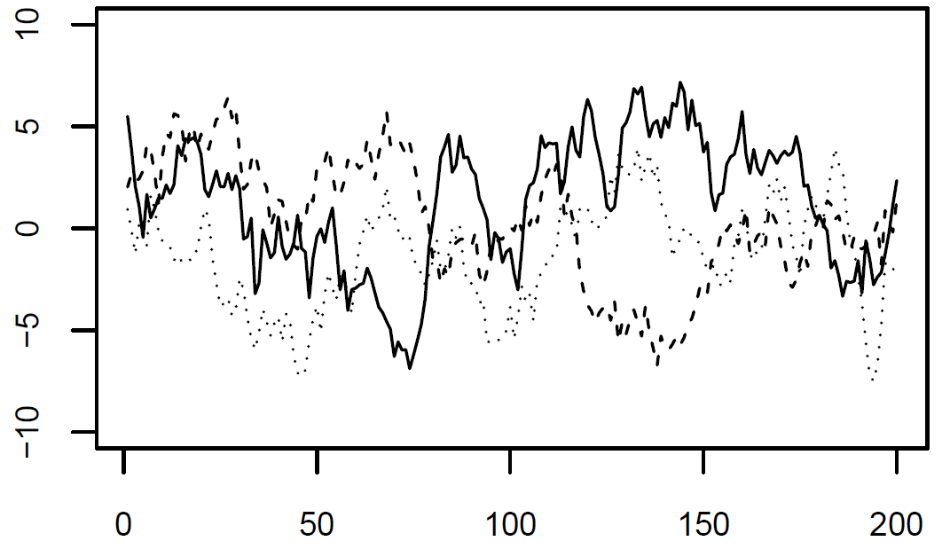
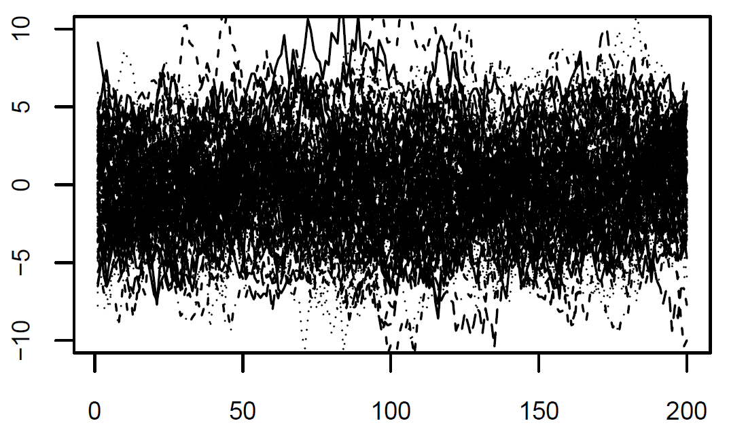
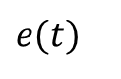
The concept of stochastic realization
$$y\left(t+1\right)=αy\left(t\right)+e(t)$$
$$e(t)$$

Slide 15
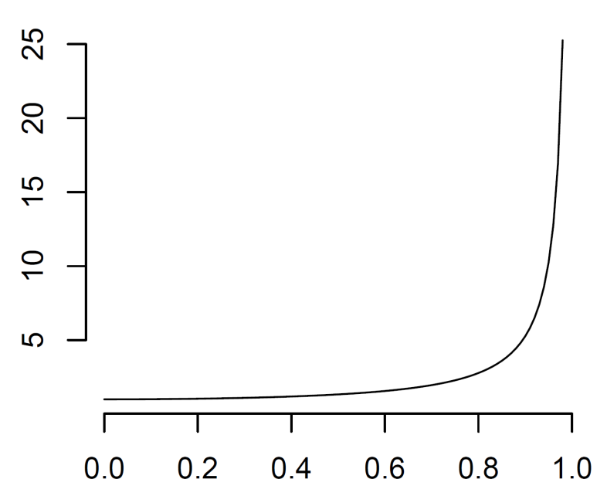
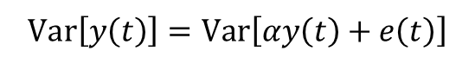
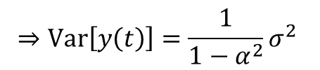
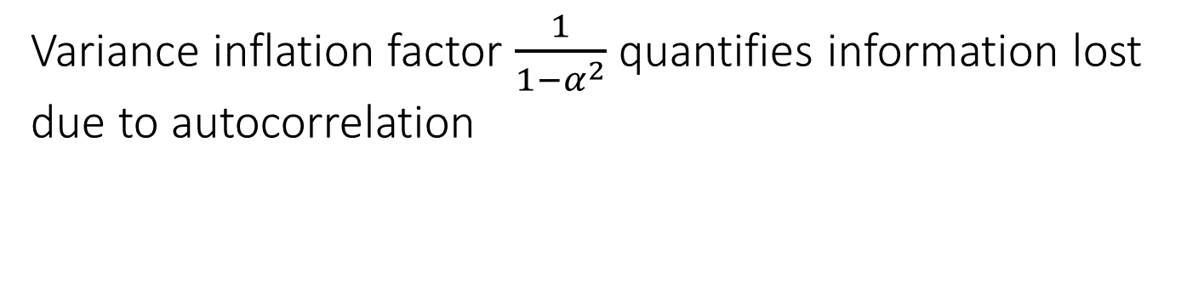
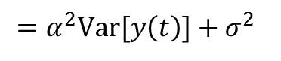
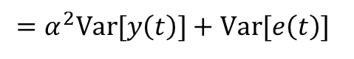
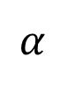
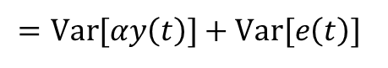
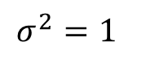
The expected variance of a temporal process
$$Var\left[y\left(t\right)\right]=Var\left[αy\left(t\right)+e\left(t\right)\right]$$
$$σ^{2}=1$$
$$=Var[αy\left(t\right)]+Var[e\left(t\right)]$$
$$=α^{2}Var[y\left(t\right)]+Var[e\left(t\right)]$$
$$=α^{2}Var[y\left(t\right)]+σ^{2}$$
$$⇒Var\left[y\left(t\right)\right]=\frac{1}{1−α^{2}}σ^{2}$$
$$α$$
Variance inflation factor $\frac{1}{1−α^{2}}$ quantifies information lost due to autocorrelation

Slide 16
Simulate autoregressive model and estimates its autocorrelation function

Slide 17
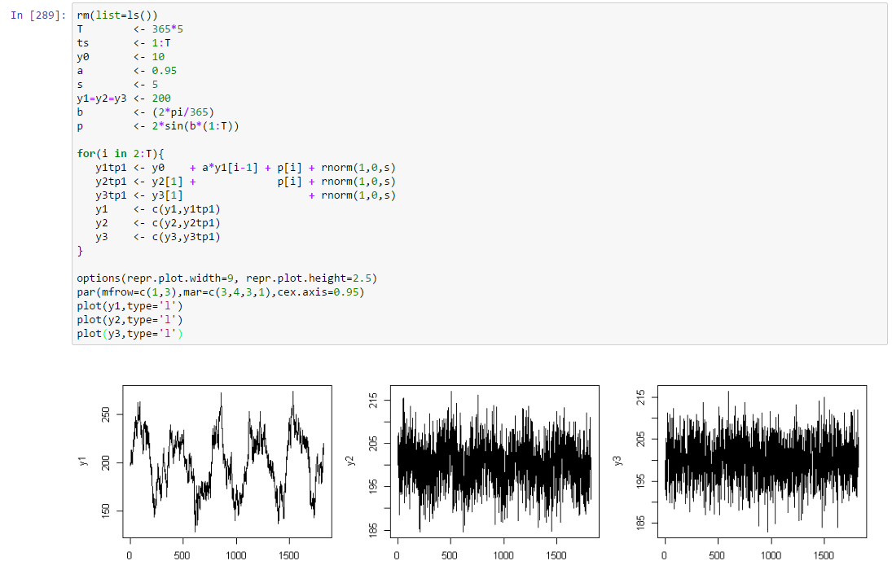
Simulate Different time series with different properties
INSERT PYTHON ALONGSIDE

Slide 18
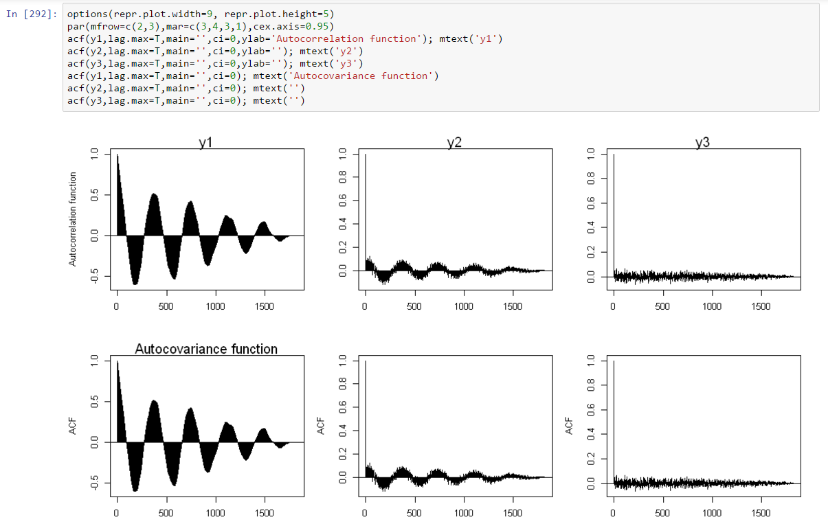
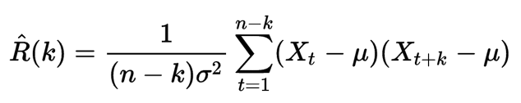
Simulate Different time series with different properties
INSERT PYTHON ALONGSIDE

Slide 19
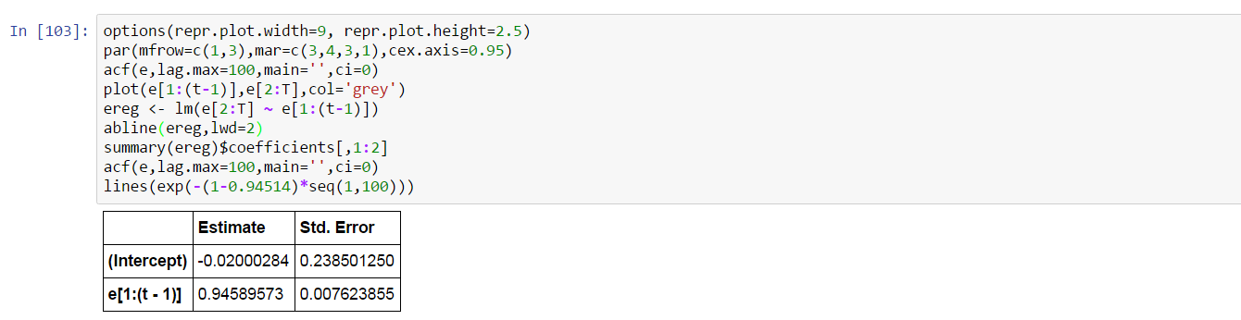
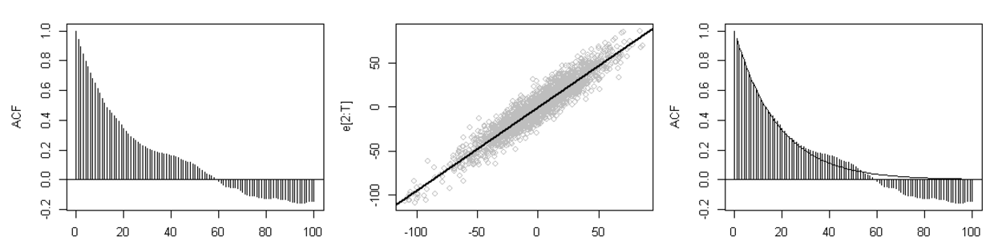
Estimate the autocorrelation function
INSERT PYTHON ALONGSIDE

Slide 20
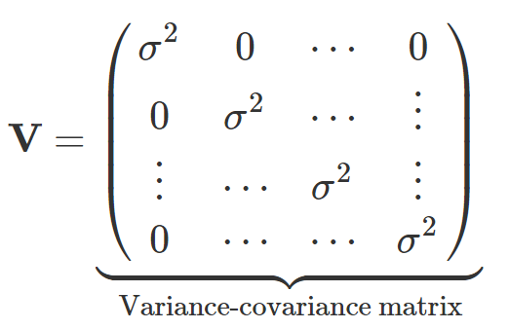
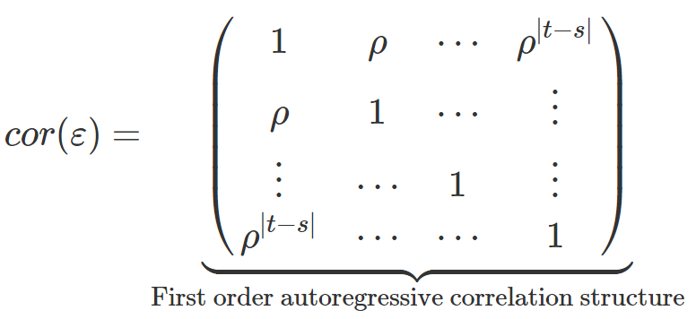
The almighty variance-covariance matrix

Slide 21

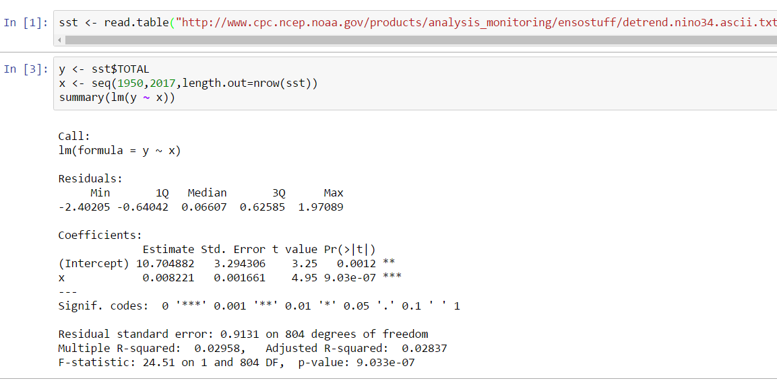
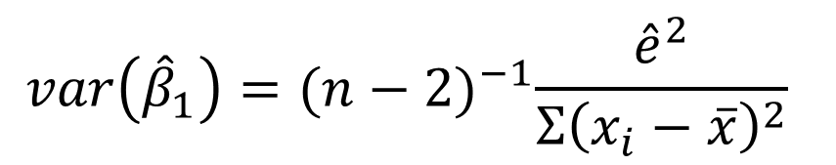
Is there a trend? ..a first attempt
$$var\left({\hat{β}}_{1}\right)={(n−2)}^{−1}\frac{{\hat{e}}^{2}}{{Σ\left(x_{i}−\overline{x}\right)}^{2}}$$
*assumes data are independent check Wikipedia for a derivation
Indicates strong evidence

Slide 22
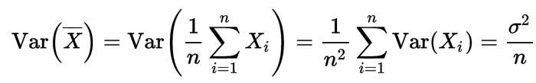
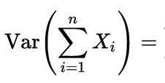
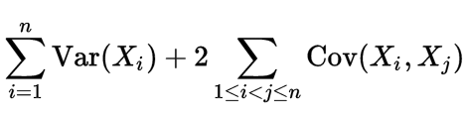
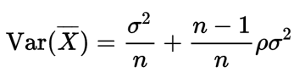
The Overconfidence of Independence
Suppose we would like to estimate a simpler quantity, the mean historical SST
*sum over elements of the covariance matrix
Assuming each pair of points Xi, Xk have correlation rho

Slide 23
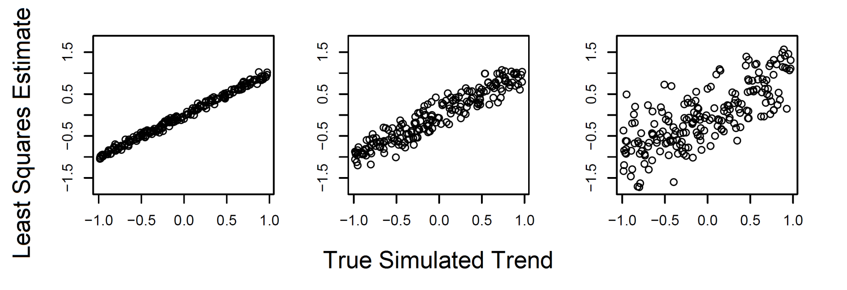
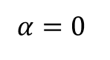
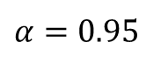
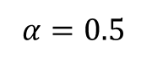
A simulated time series with known trends
Simulate 200 datasets with trends and try recovering the parameters with alpha = {0,0.5,0.95}
Variance of slope increases with autocorrelation
Basic standard error formula ignores this, like in the mean formula
Rule of thumb: n_effective(alpha) ~ (1-alpha)n
$$α=0$$
$$α=0.5$$
$$α=0.95$$

Slide 24
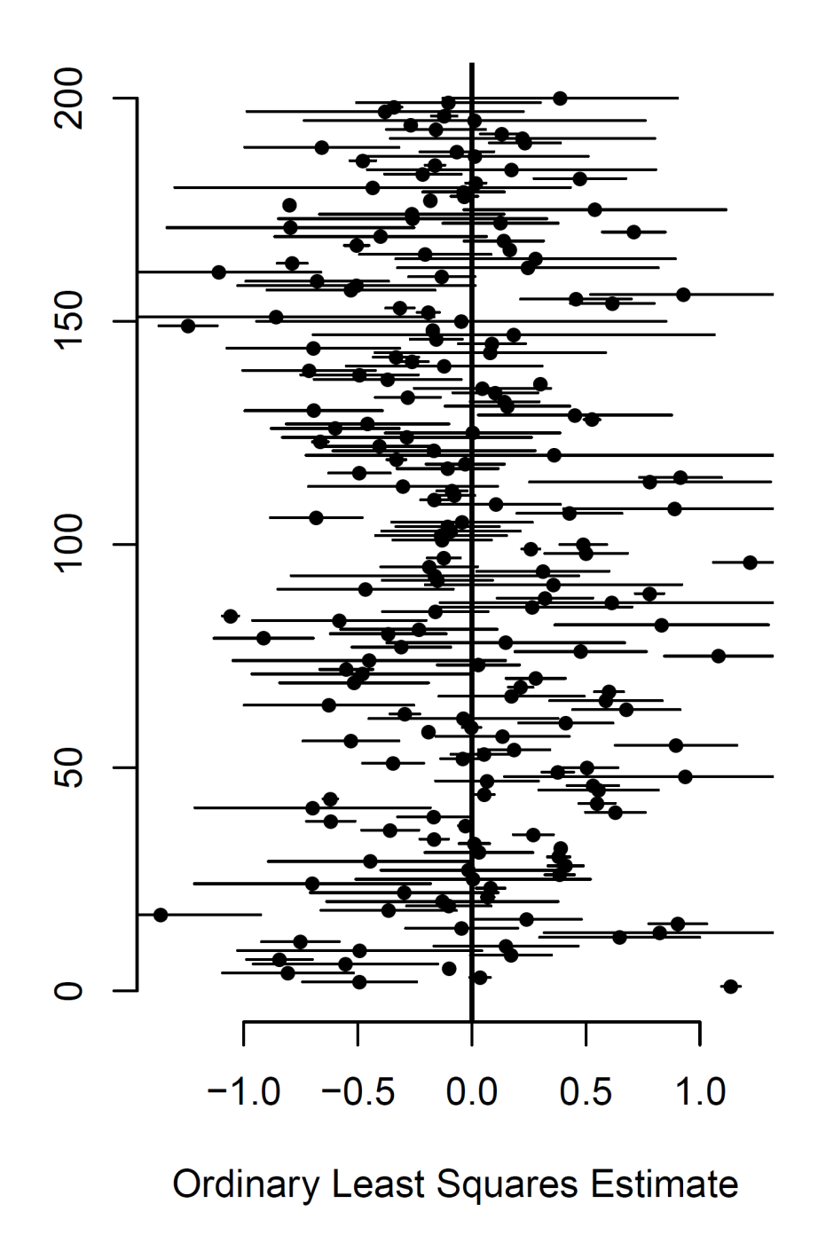
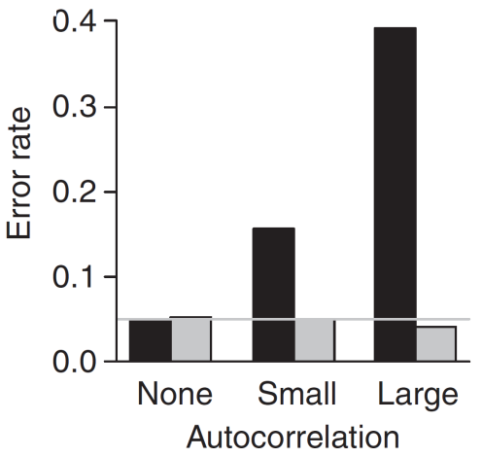




The statistical implications
Simulate 200 datasets with trend = 0
2*standard error misses the ‘true value’ ~ 40% of the time with $α=0.95$
$$α=0.95$$
$$α=0.5$$
$$α=0$$

Slide 25





$$α=0.95$$

Slide 26



Fitting a Model with Temporal Autocorrelation
Indicates much weaker empirical evidence!

Slide 27
BREAK

Slide 28


Dataset #1: Ozone time series at single station
What’s Going on with the Air we Breathe?
EPA Air Quality Station Data, Orange County

Slide 29
Time series of ozone data

Slide 30
Simple Trend Analysis

Slide 31




Harmonic regression

Slide 32
Harmonic regression

Slide 33
Aliasing

Slide 34

Time Series Decomposition

Slide 35
Time Series Decomposition
A temporal trend is best thought of ‘what’s left over’
This can be extremely difficult to ascertain when the dynamics of the process are not precisely known

Slide 36
Correlation and regression with time series

Slide 37


Model Selection

Slide 38
LUNCH

Slide 39


What Generates the Pattern? Key concept: correlation as a function of lag
In space, this pervasive phenomena generates pattern
This simple fact has broad implications that can play tricks on our ideas about science!

Slide 40
Autocorrelation functions

Slide 41


Slide 42

Simulate spatially autocorrelated data

Slide 43

Simulate spatially autocorrelated data

Slide 44

Temperature and Precipitation
Climatology of Oregon

Slide 45



Slide 46
Spatial interpolation

Slide 47

Spatial Regression

Slide 48

Spatial Regression

Slide 49

Construct a new variable

Slide 50
Wrapping Up
Learned basic concepts, datasets relatively small
Two-day workshop next year using Stan

